Slide 1
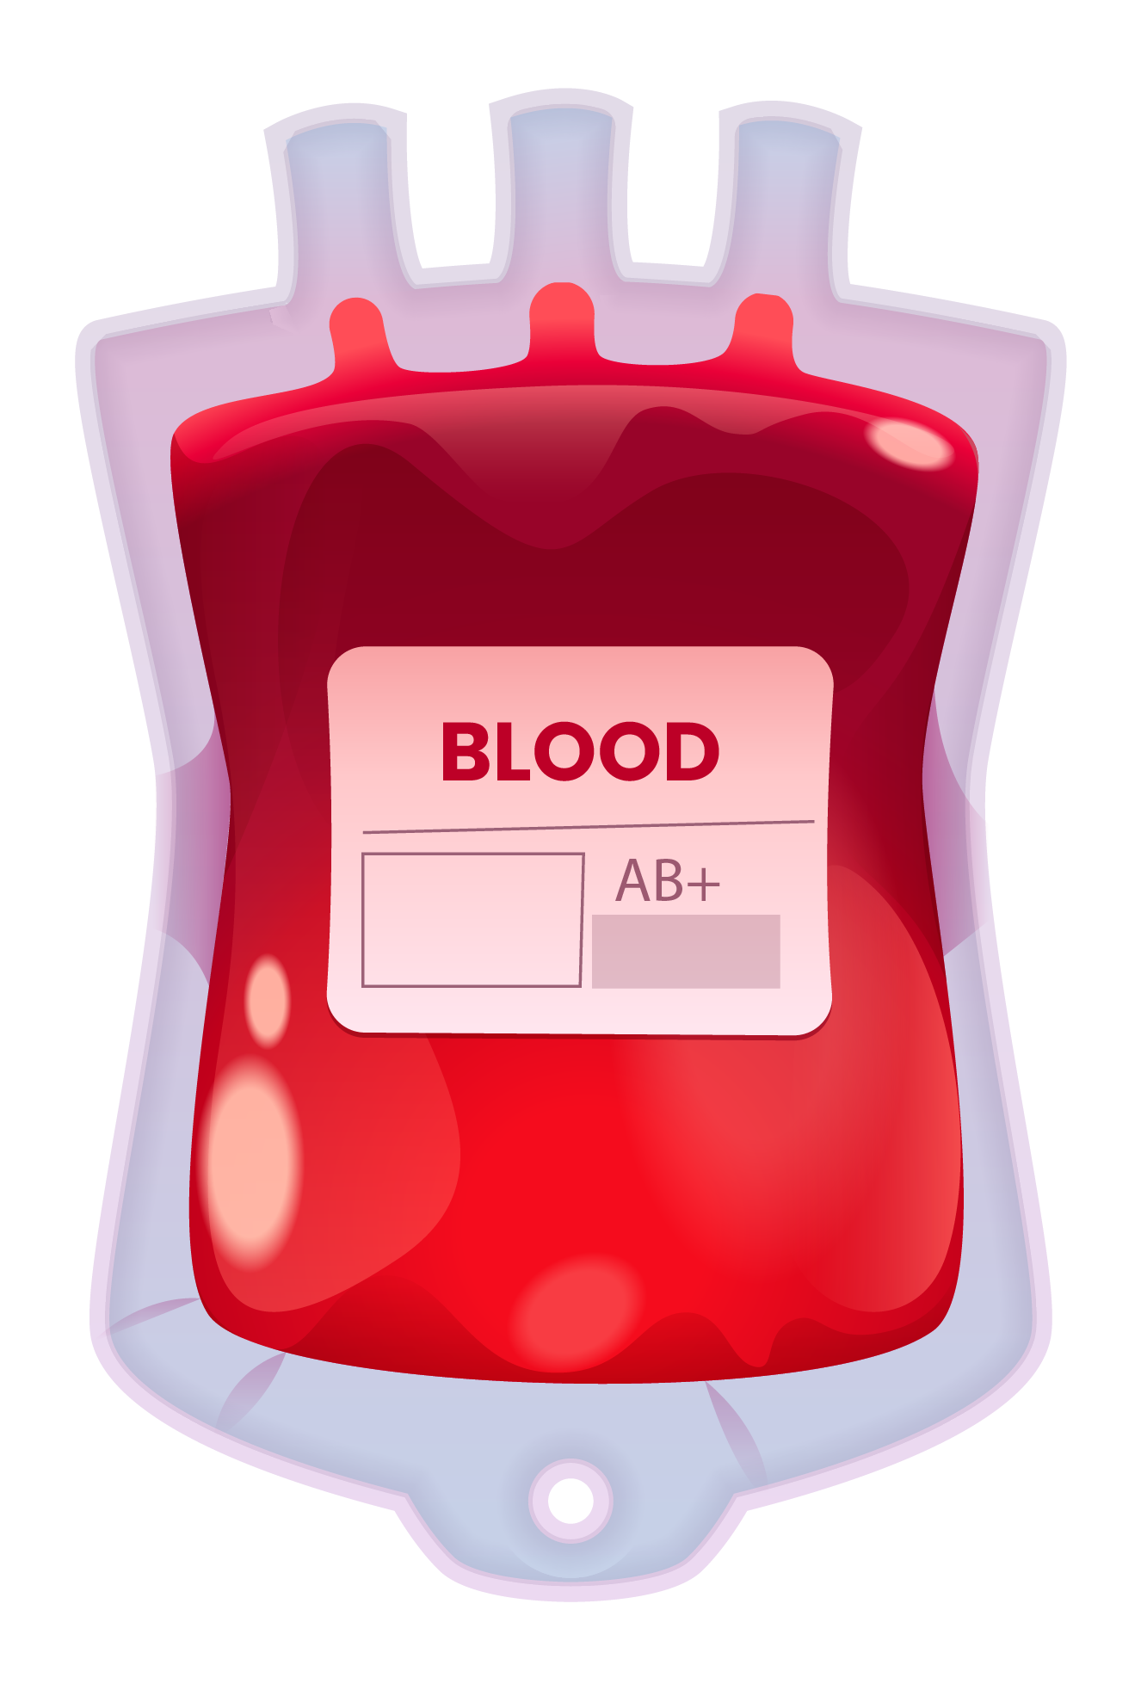
BLOOD BANK DONOR MANAGEMENT SYSTEM
Review 2

Slide 2


TABLE OF CONTENTS
01
02
ABOUT THE PROJECT
PROTOTYPE DESIGN
03
COMPLETE FRONT END DESIGN

Slide 3
Abstract
In the present digital age, a vast number of online blood bank databases are available for usage, however despite their sheer number no notable online blood bank database offers the capability for the direct contact between the donor and the recipient of the donation. This can prove to be a major drawback particularly in cases where there is an urgent need of blood and families scramble to find someone through social media. Our work therefore aims to overcome this communication barrier that can potentially cost someone their life by creating a blood bank database of our own through a web interface containing the relevant details collected from various types of sources such as other Blood banks, NSS, NGO's, hospitals. The data collected from these sources will be maintained in a central server by a database administrator of our interface. This initiative of ours intends to help in keeping track of all information about blood donors and the various blood groups accessible in each blood bank. The goal is therefore to increase transparency in this industry, making obtaining blood from a blood bank simpler, free of any potential corruption, and improve the general blood bank management system. Instead of stocking blood, we are stocking information on blood donors for our userbase. The entire project is being developed keeping in mind the distributed client server technology.

Slide 4






Problem Statement
Blood is one of the most important fluids sustaining human life and its absence can be a large problem that the medical world is still trying to tackle. With the recent Covid-19 pandemic that the world went through, blood banks and social media was submerged with tons of requests for blood of different blood type groups, creating much panic as emergencies were at an all-time high and blood recipients had a hard time finding donors. Currently there is no substitute for human blood despite more than 70 years of research, making it extremely useful for an emergency live saving situation. In a medical case of loss of blood, the only valid option is to find blood donors to save the patient’s life, which becomes harder with an imperfect blood donation management system where there is no proper communication and donor details are harder to find. Not to mention reports of corruption when it comes to blood bank management are also rampant, creating distrust towards the industry as there is no transparency. Therefore, we through this project aim to create a web interface through which donors can easily apply and volunteer to donate their blood and the recipients who need blood can easily access and find a perfect donor for their respective emergencies, without too much of a rush and panic.

Slide 5

Reason for choosing this topic
Some members of our group have been part of NGOs, and with the recent Covid-19 pandemic we have unfortunately witnessed multiple outcries for help regarding the need for a donor for a patient who was in critical condition and needed an immediate blood transfusion. With social media as well set ablaze with tons of requests from friends and family members regarding blood donors, and the lives lost due to not receiving blood in time, we feel it is imperative to look at the situation closely. While blood shortage is indeed a significant problem, as per our observations even when there is blood available for the recipients, they have a hard time finding the required donors who can help save their lives. Communication, therefore proved to be a major hindrance in this process where due to not having proper details of the donors and not being able to access those details, blood recipients lost their lives. Therefore, creating a web interface aimed at tackling the issue of communication and transparency seemed like something that is necessary and something we want to attempt to combat this issue that has unfortunately become a common scenery in our daily lives as of late.

Slide 6
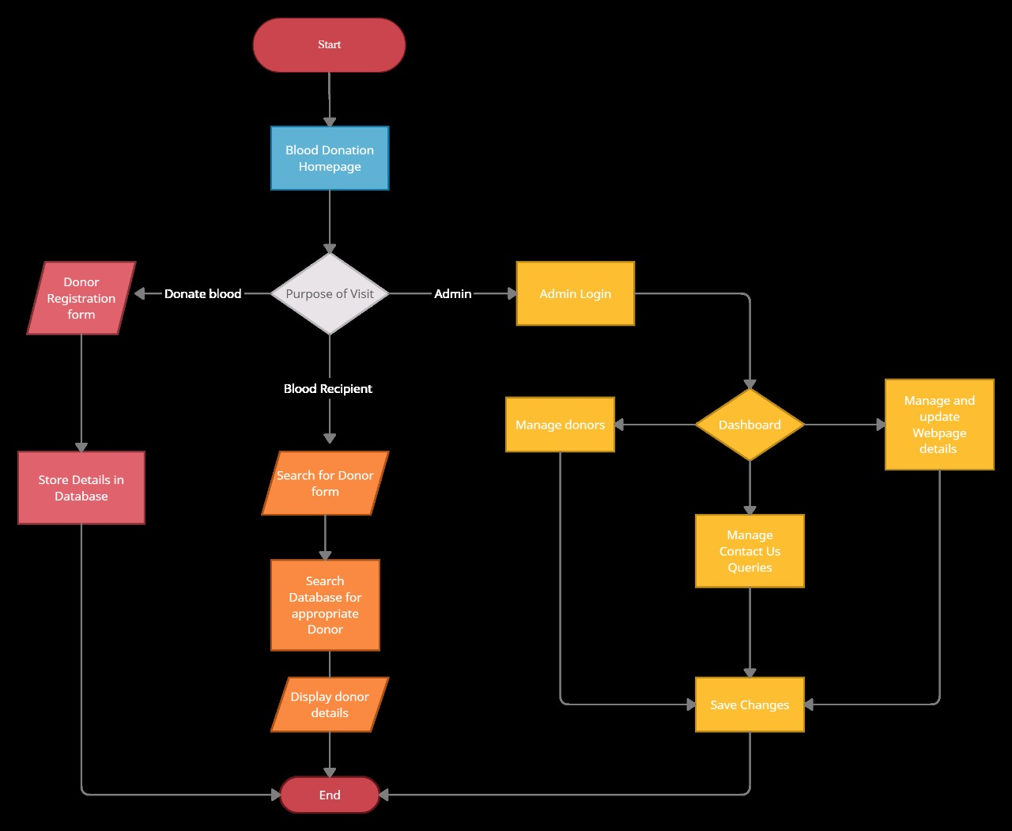
Process Flow Diagram

Slide 7
MODULES
MODULE 1 – ADMIN/USER MODULE
A separate Admin access is needed for our interface to tackle menial tasks such as searching for any duplicate
donor submissions, for granting the requests of both the donor and receiver, for the addition and deletion of
information, for scanning any fake requests, for updating any information, etc. which has to all be done to
ensure smooth operation of the blood bank.
The website we will make can be therefore accessed by Admin and by the User. The interaction part of our site
where users will request and read their needed blood groups, the contact details, and other blood group
details will be done in this module along with the management of tasks done by Admins, covering the Front end part of our system.
Tools used for this module are PHP, MYSQL.
All the entered details and updated details will be stored in the server of our interface in a systematic manner,
serving as the backend part of the system. This module will therefore handle the actual data storage.
Tools used for this module are HTML, CSS, JavaScript.
Module 2 - Server

Slide 8
OUR TEAM
Rajarshi Bose
Fahad Dalwai
Anshuman Gupta
20BCE2574
20BCE0610
Sai Akshara
20BCE2258
20BCE2119

Slide 9
THANK YOU

